Slide 1
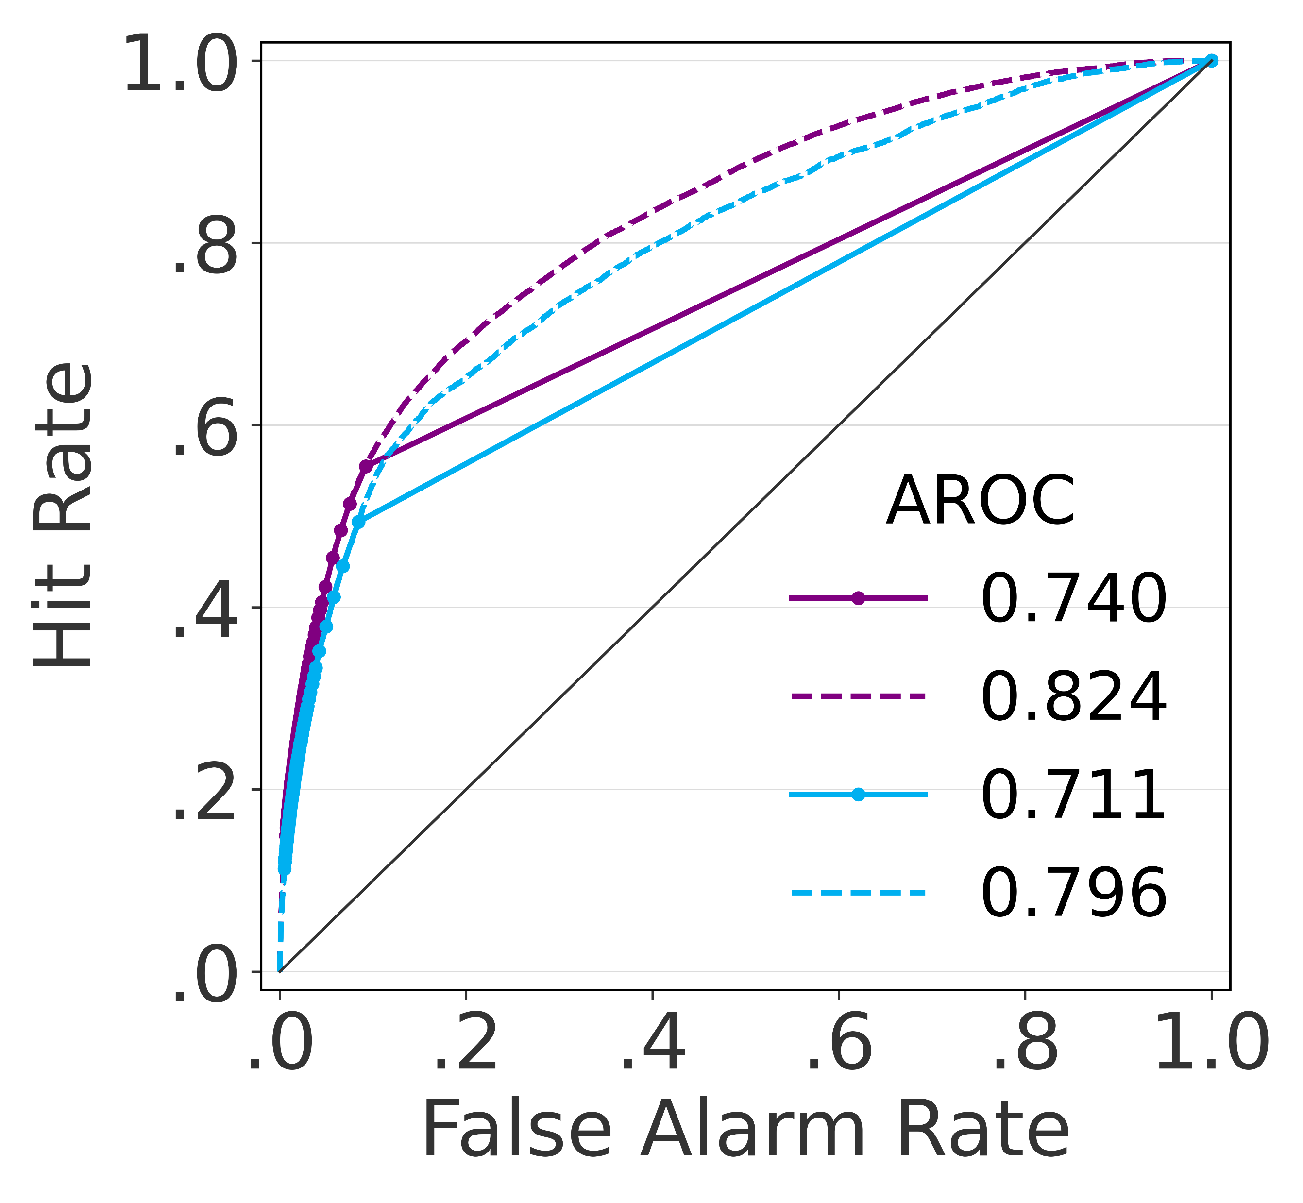
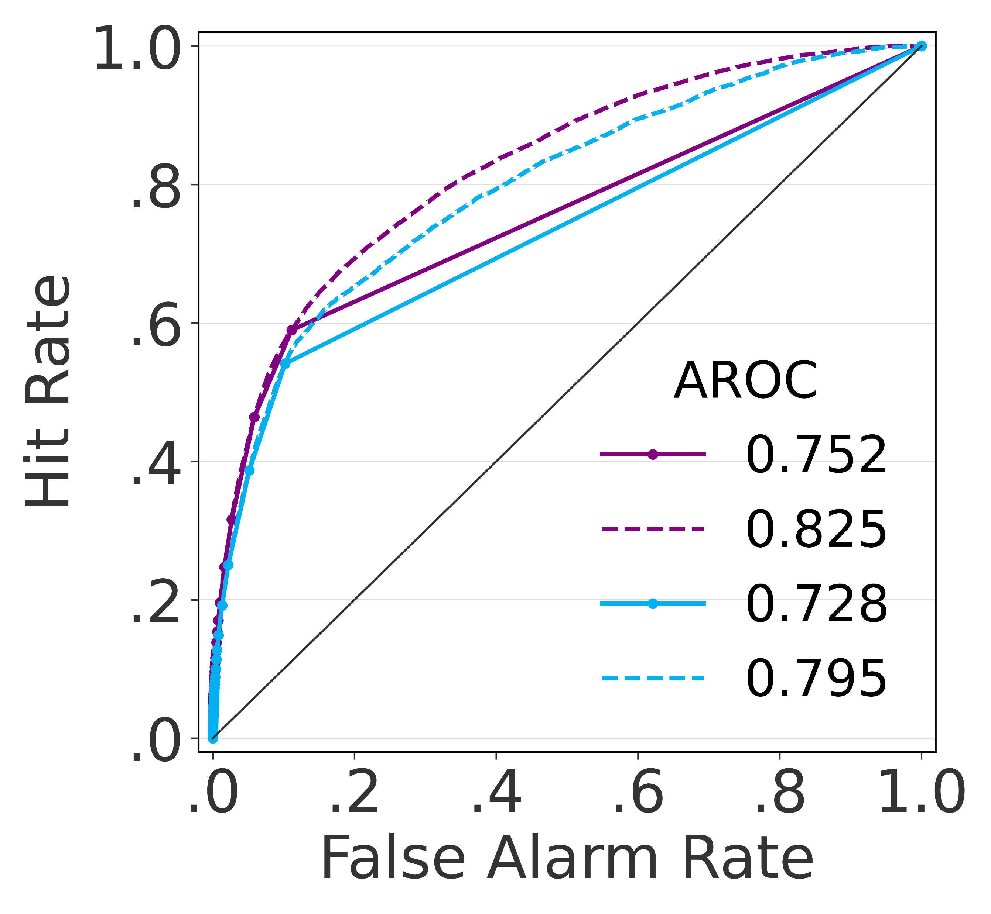

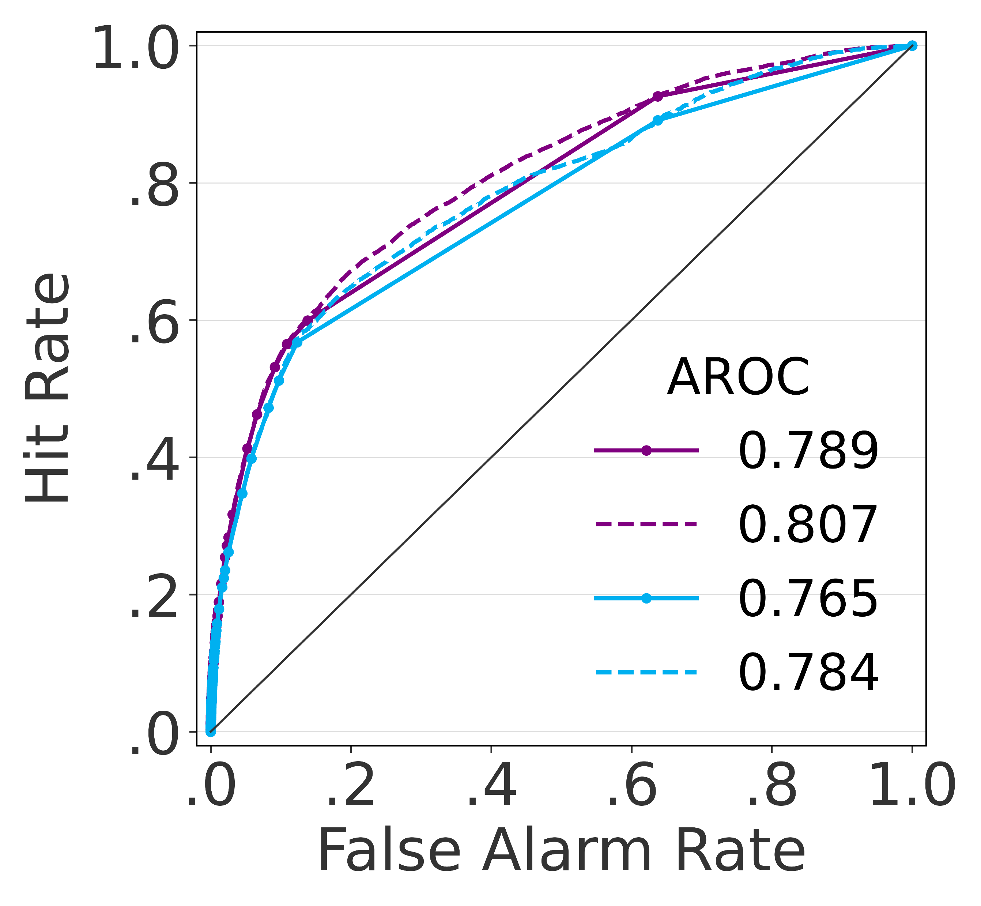
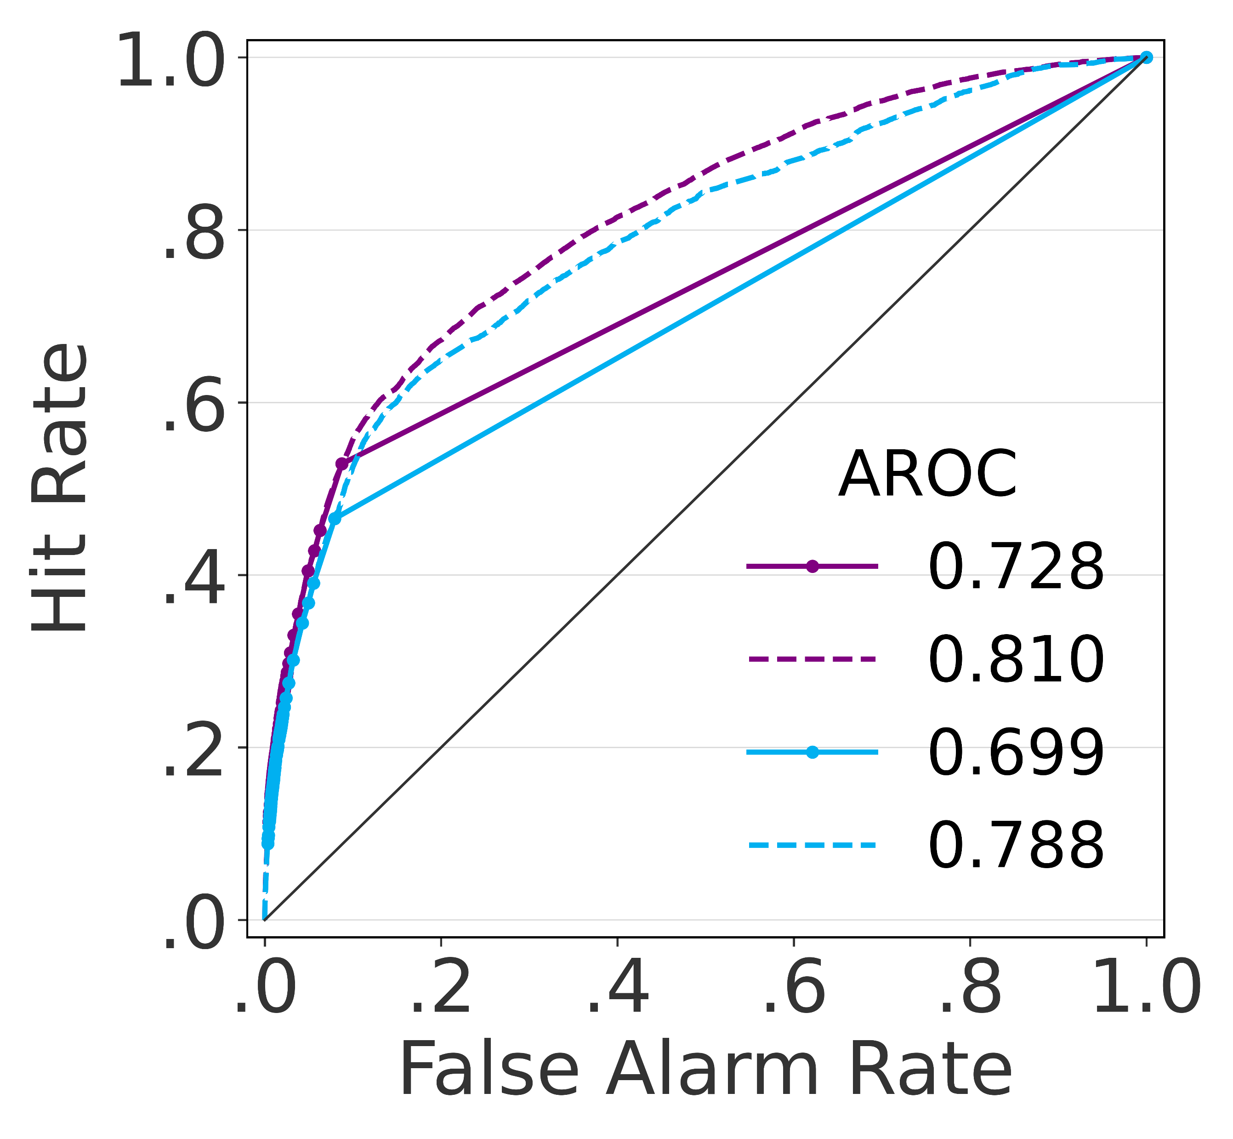
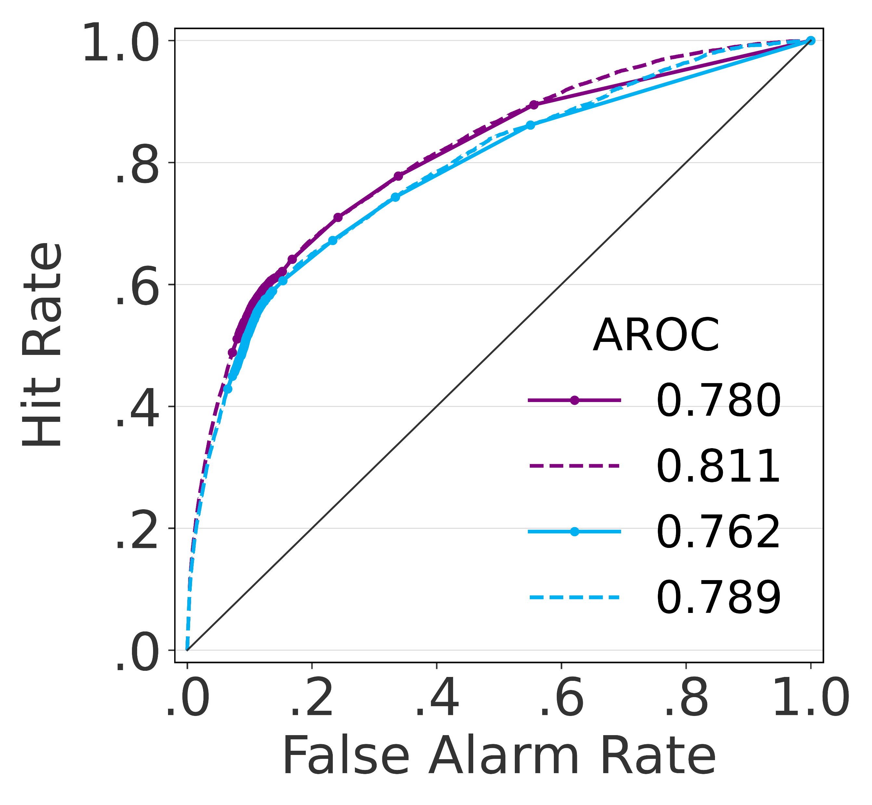
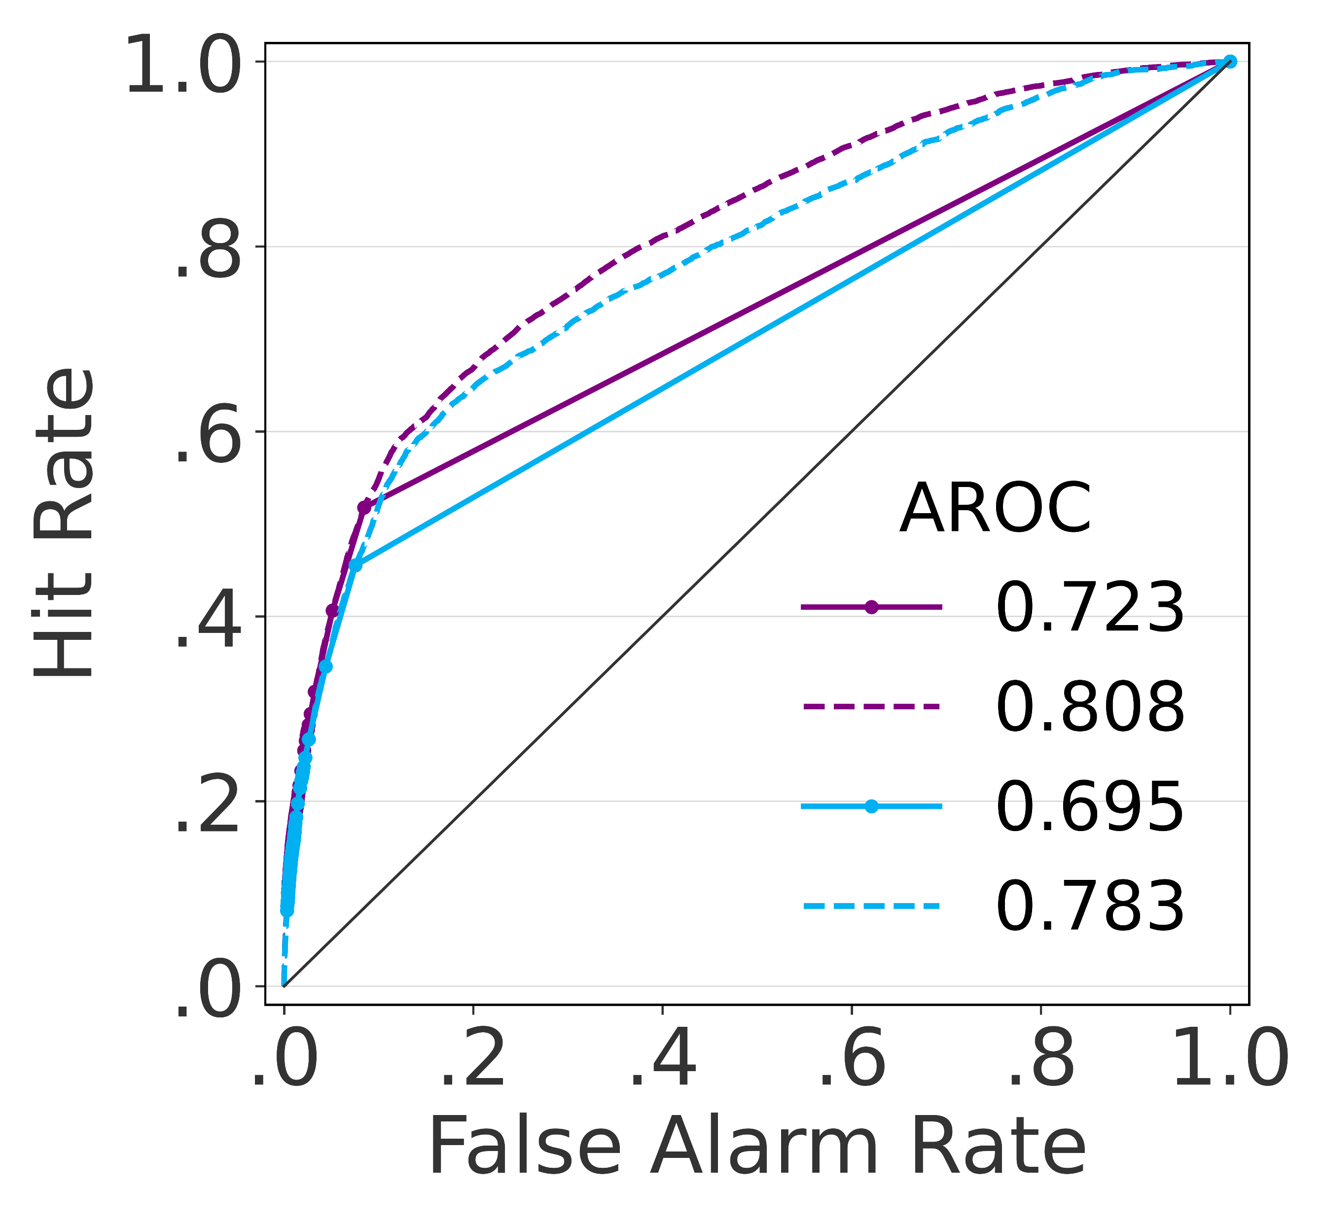

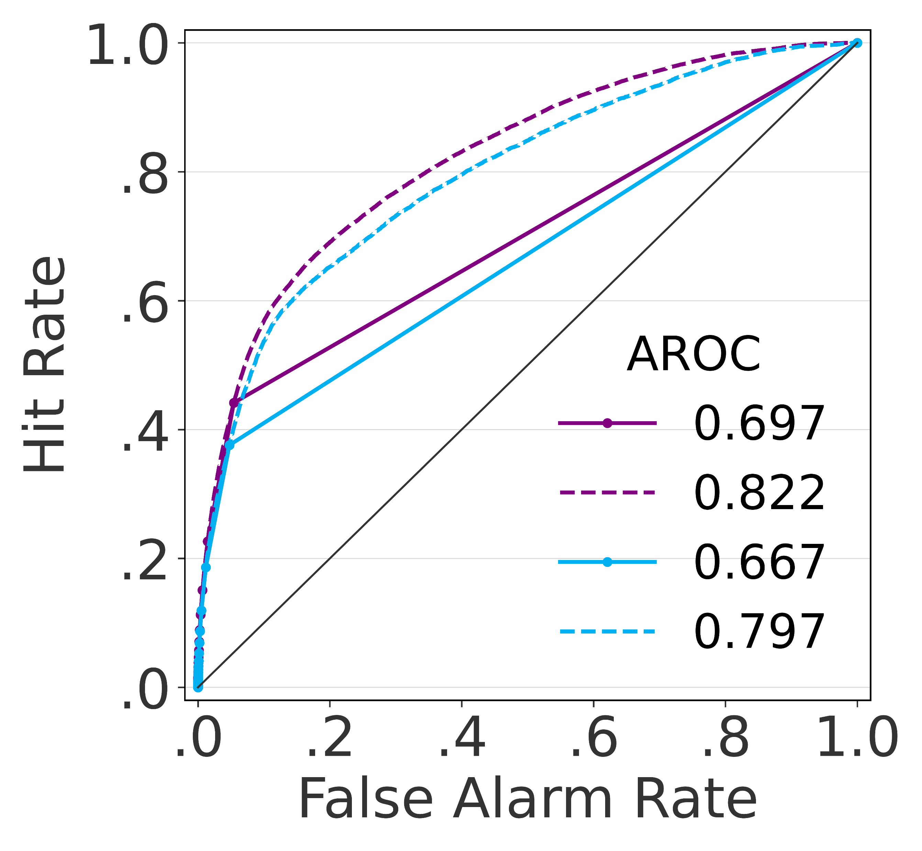
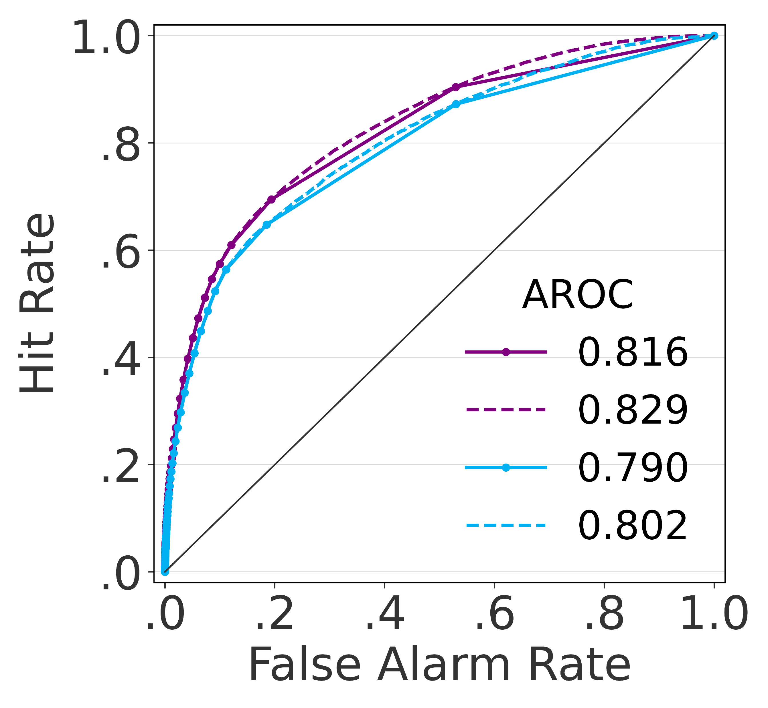

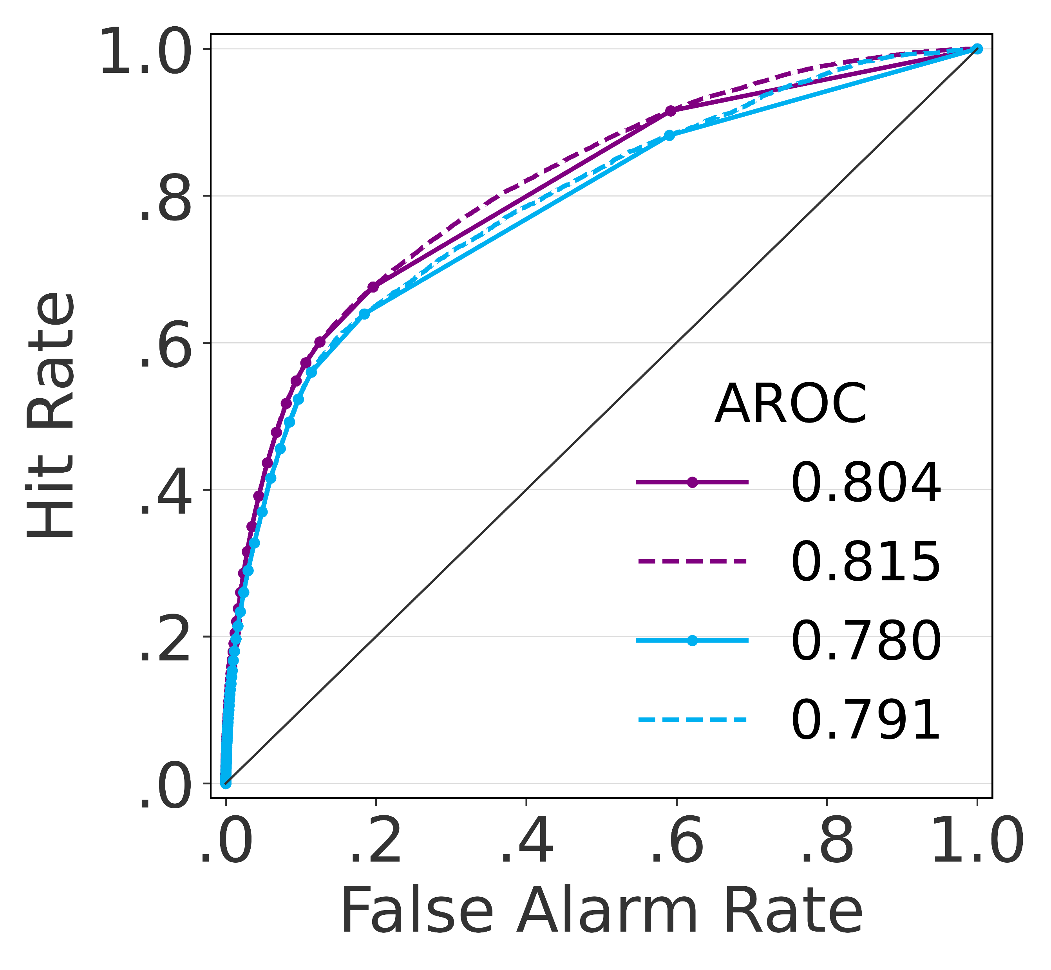


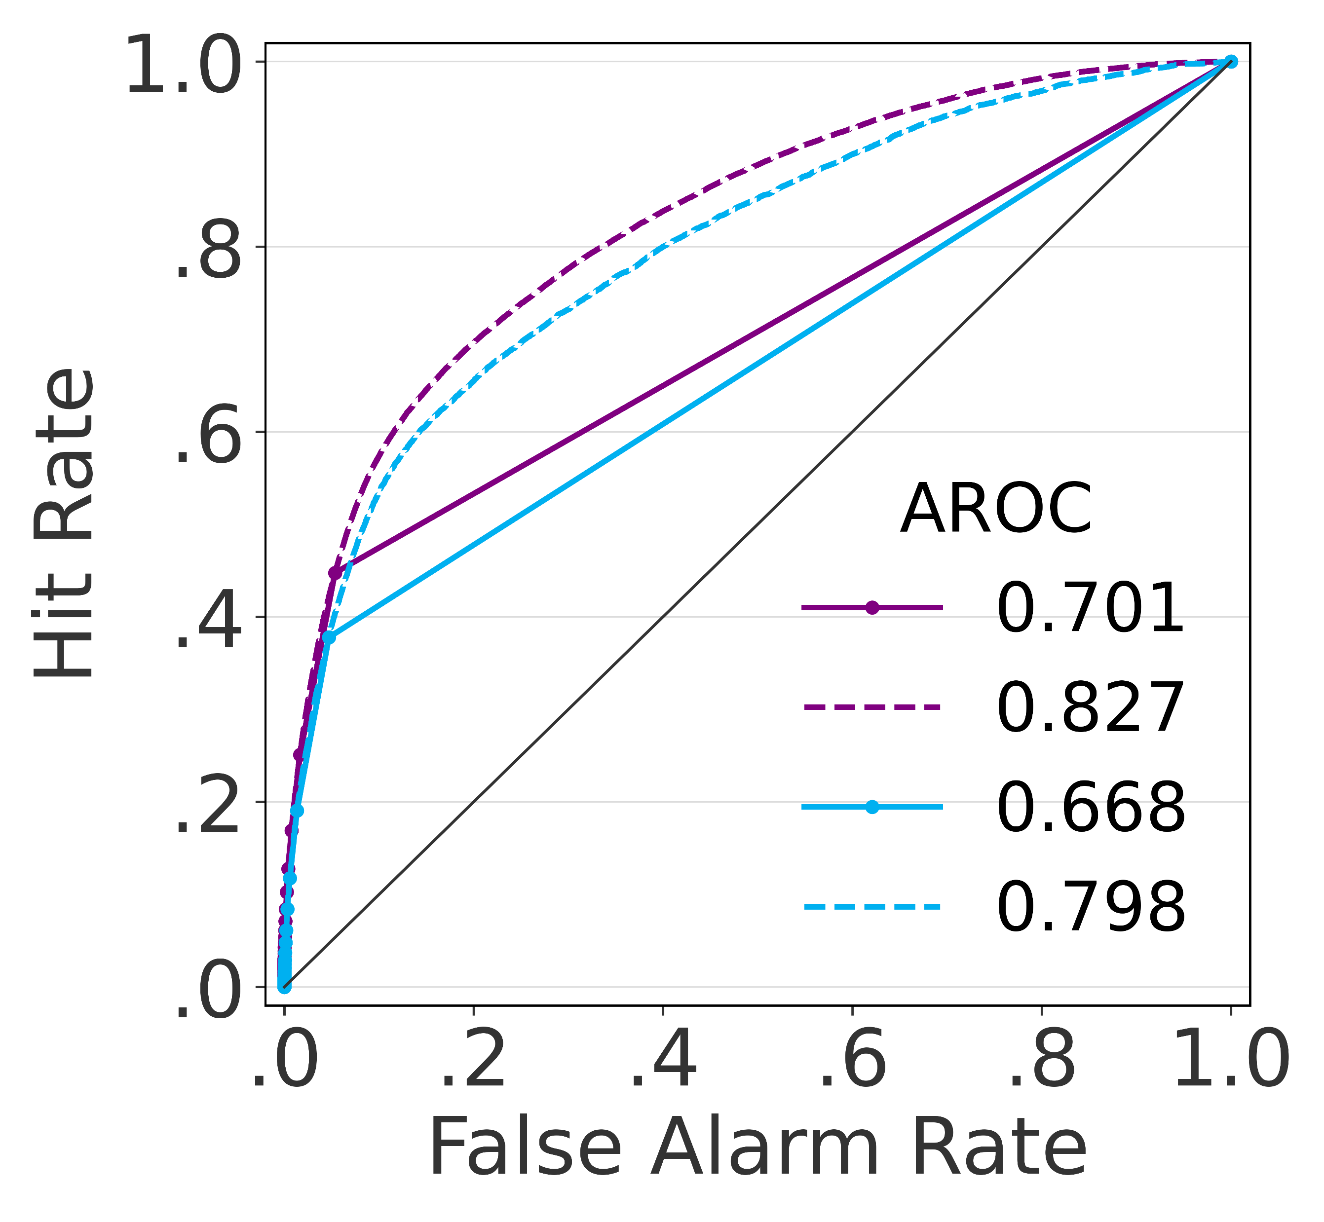


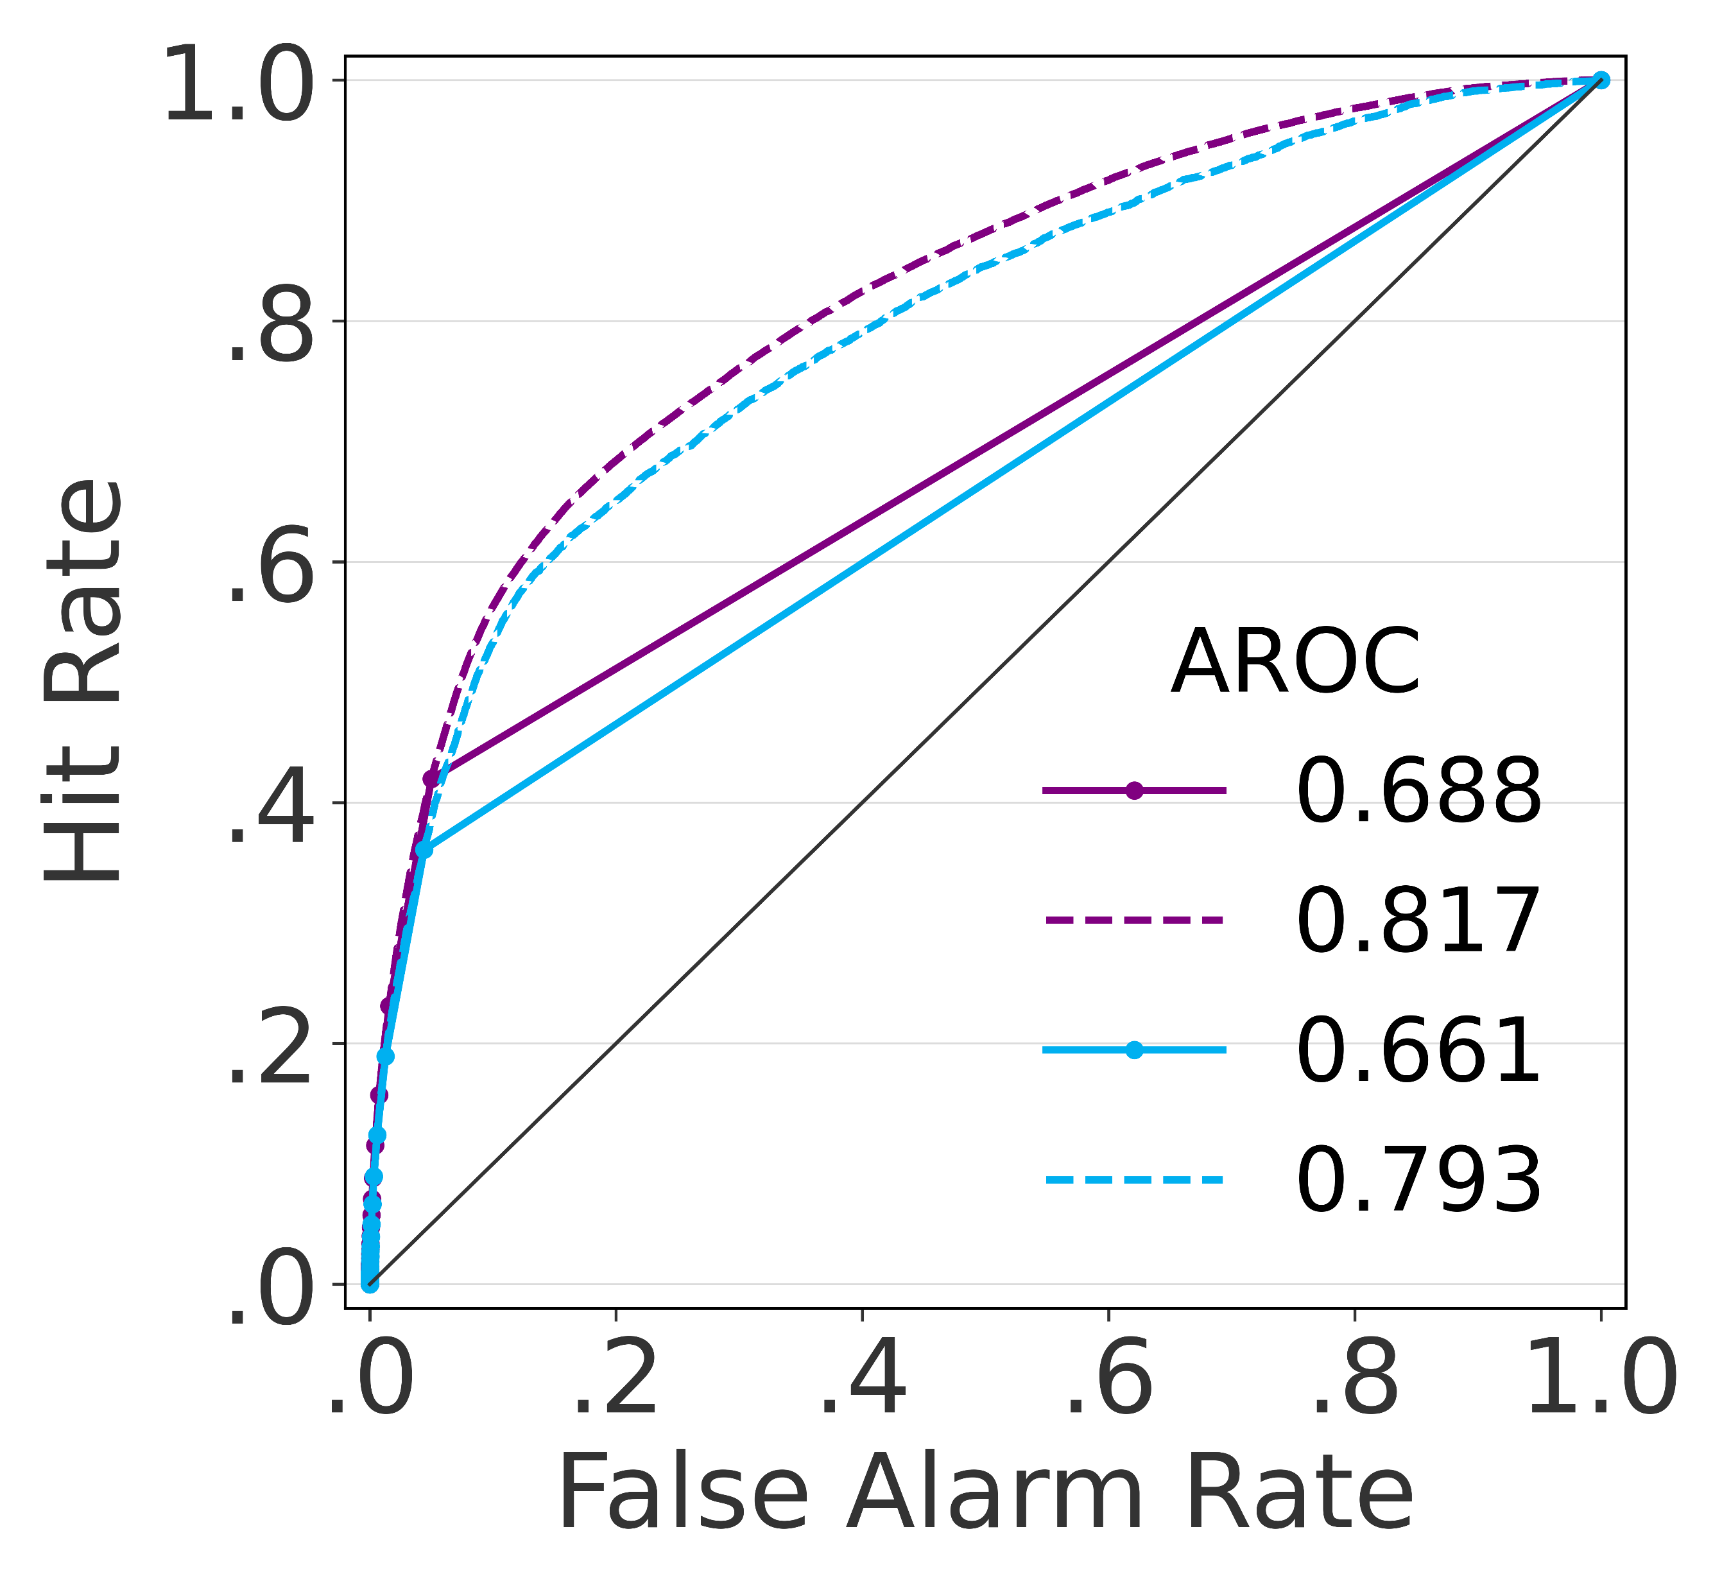
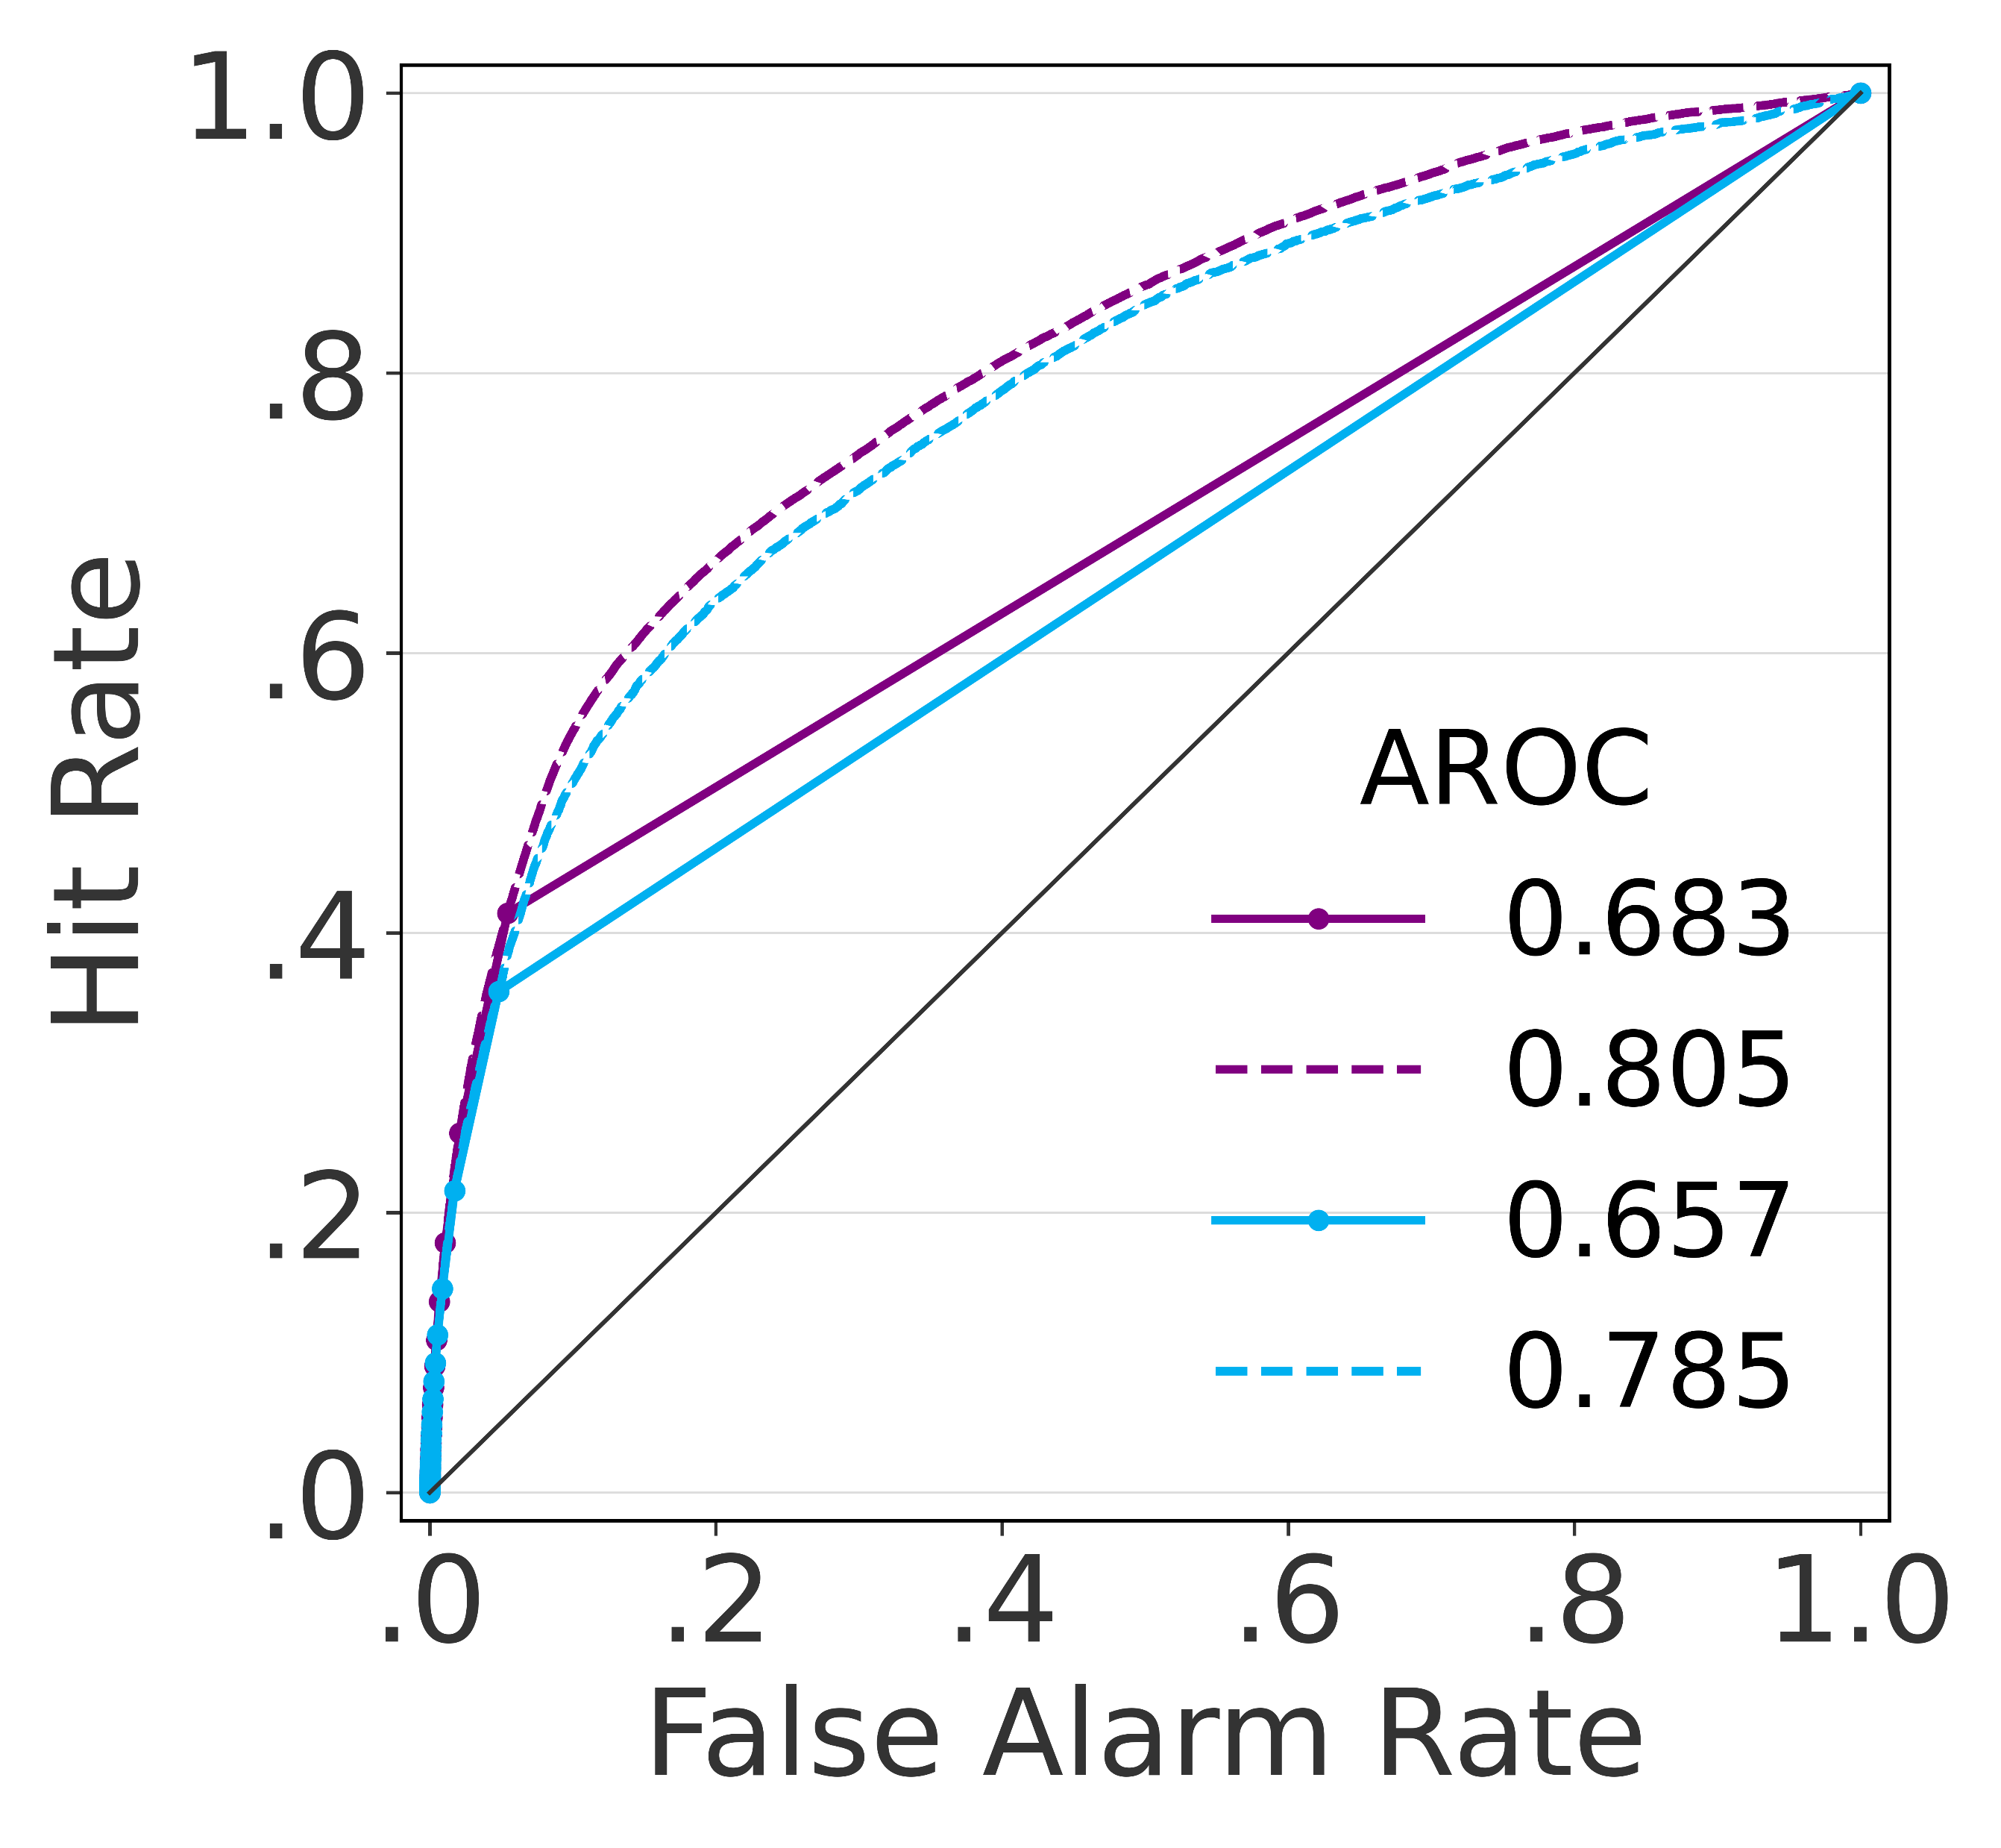
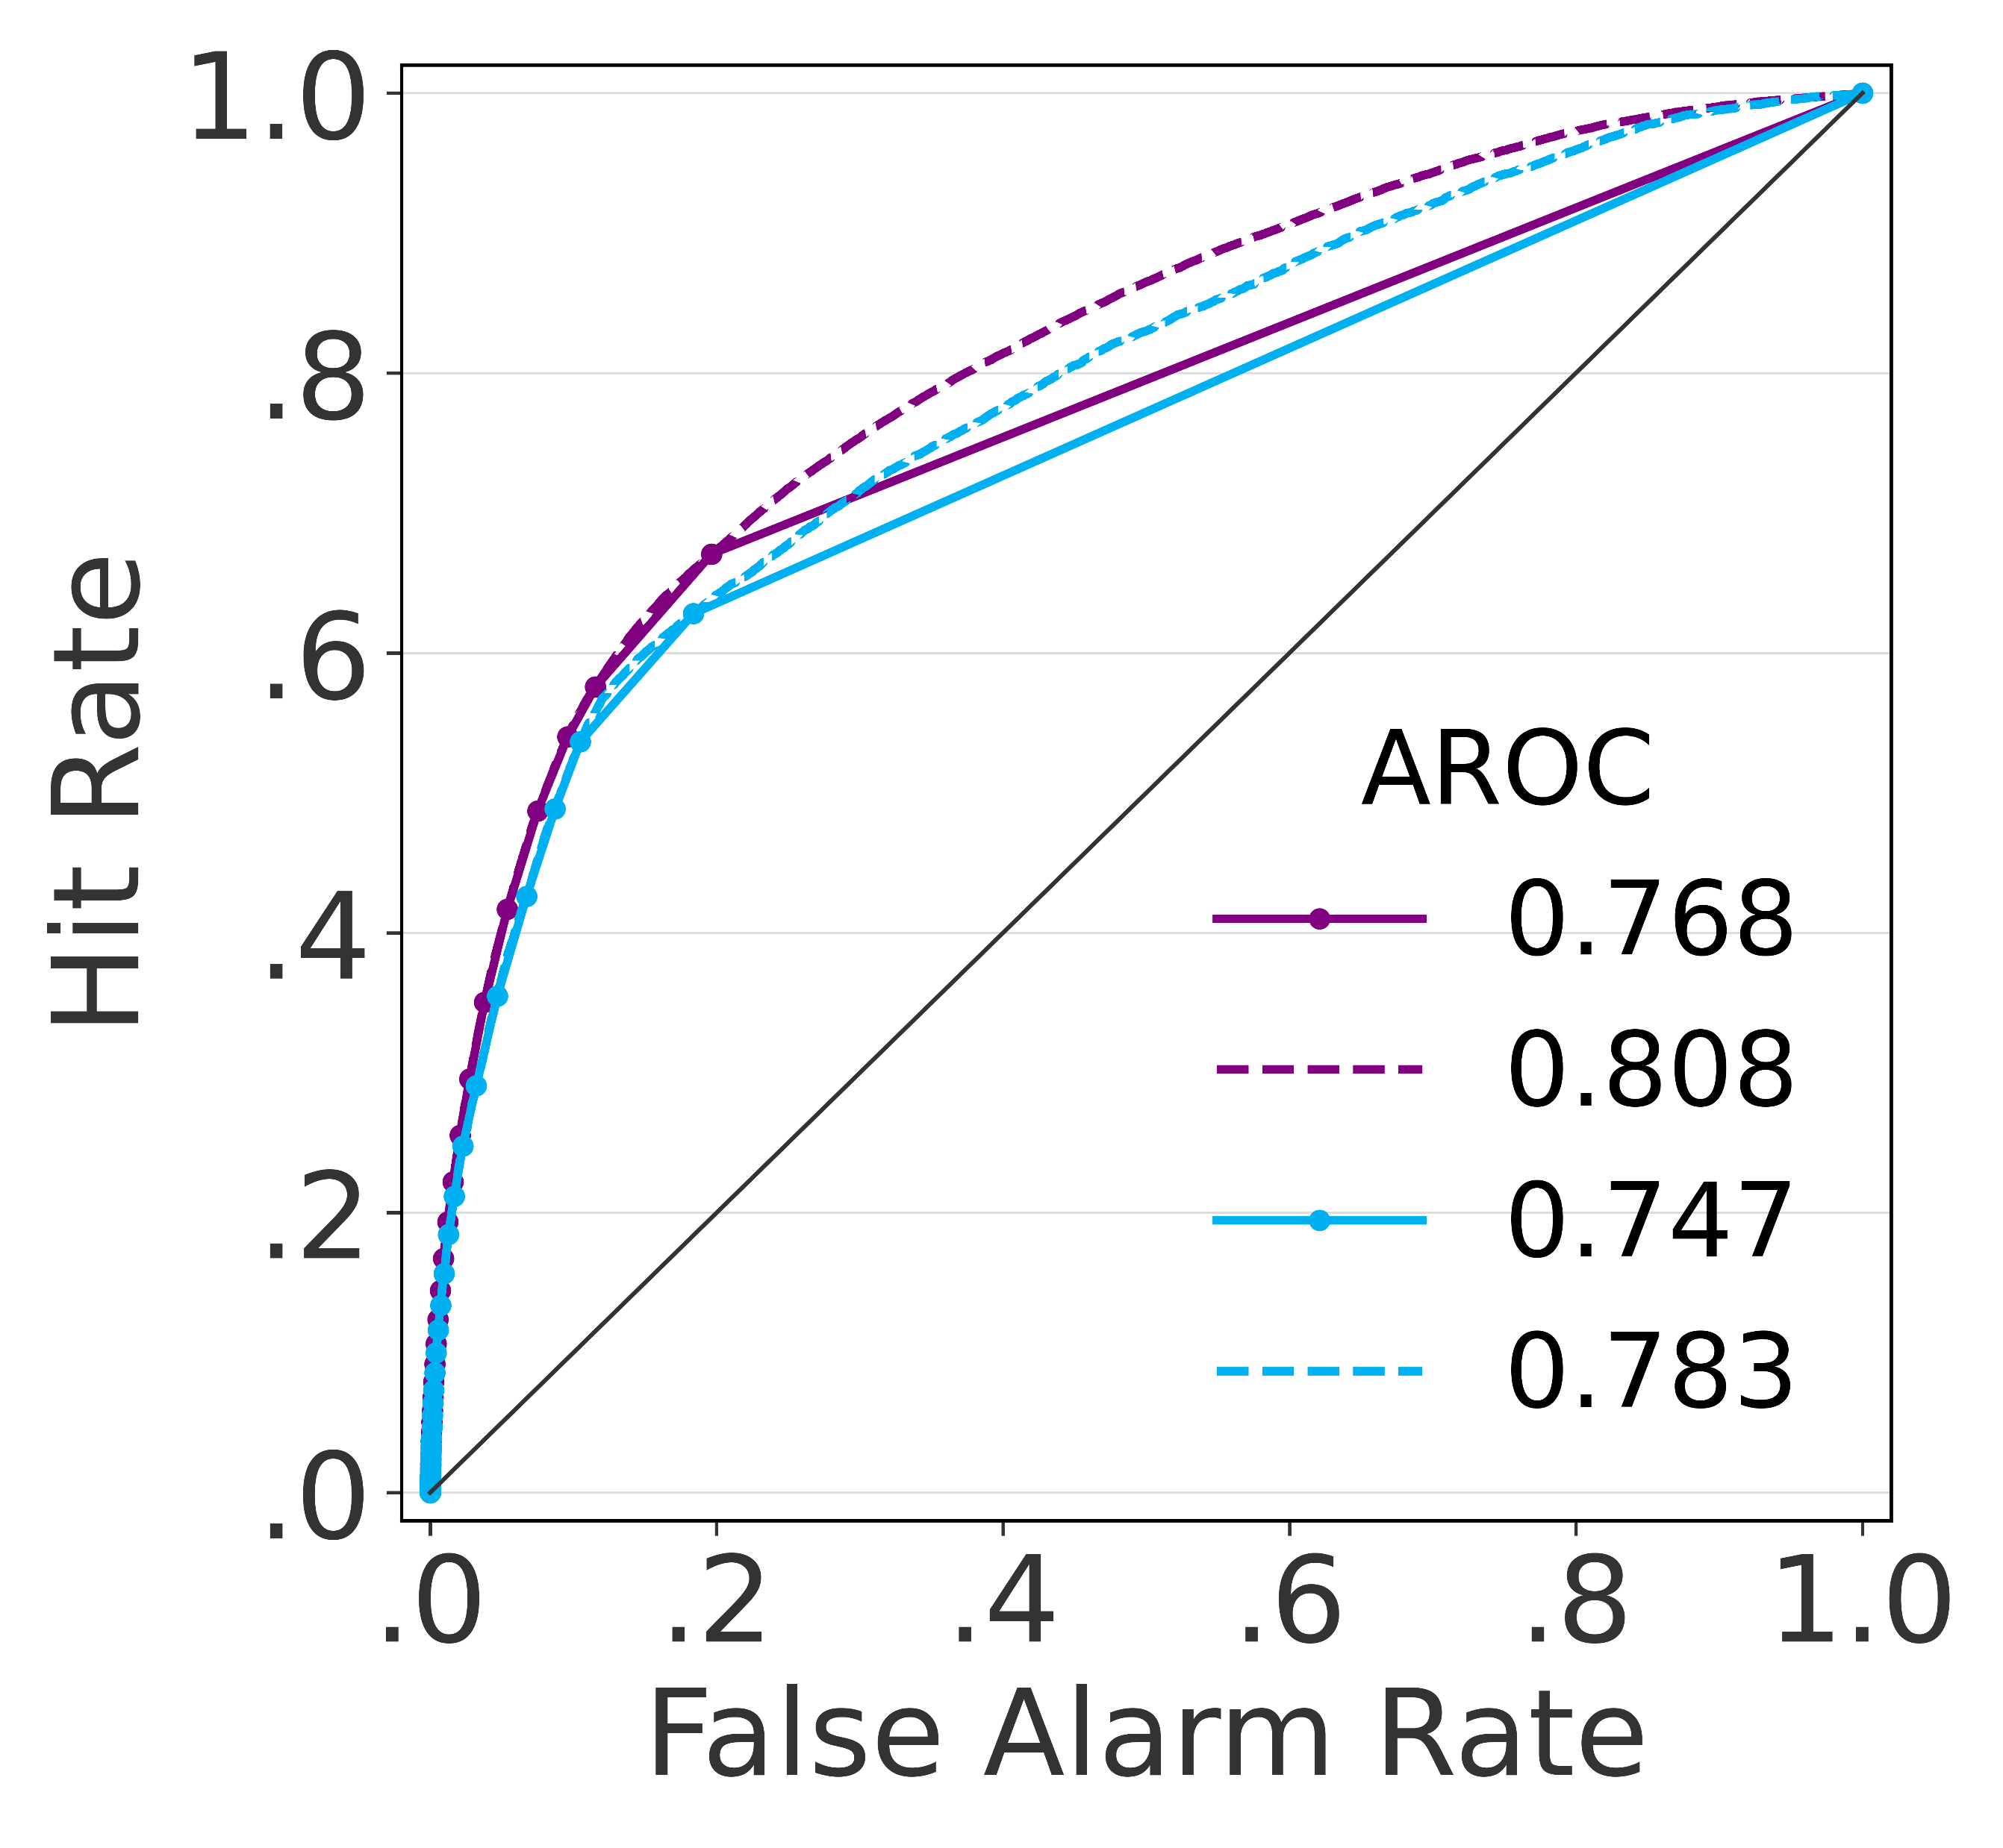
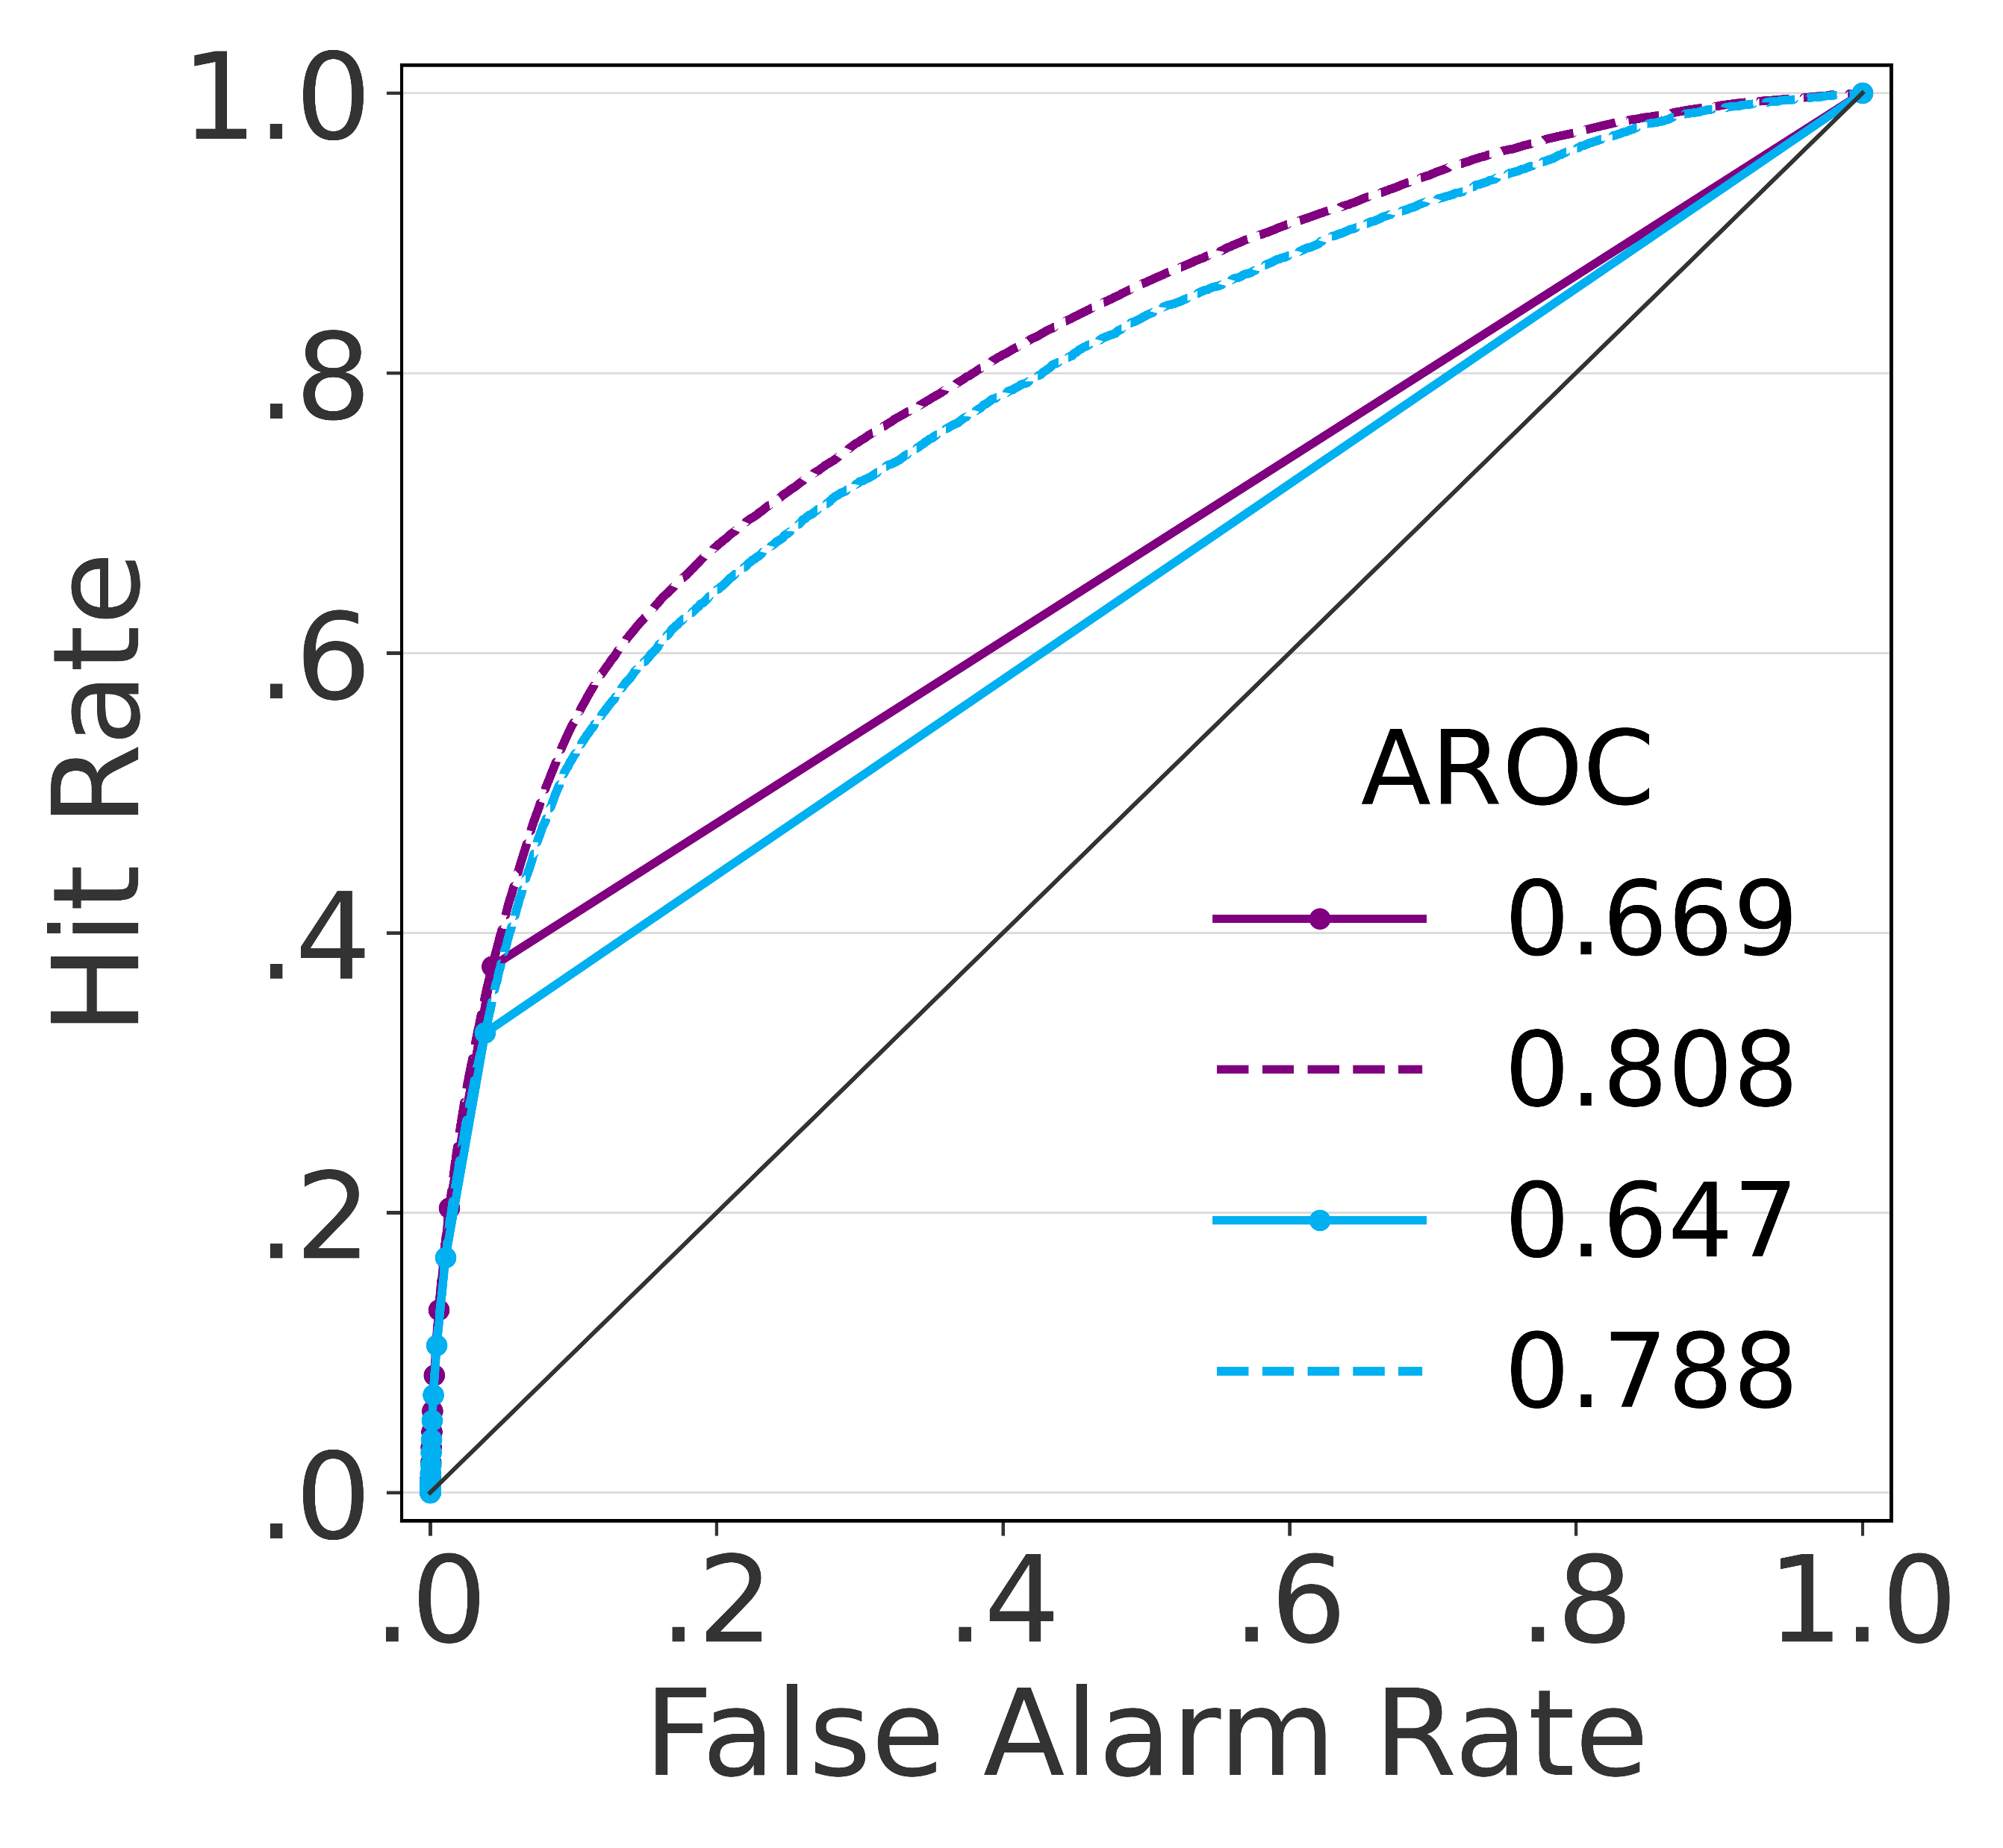
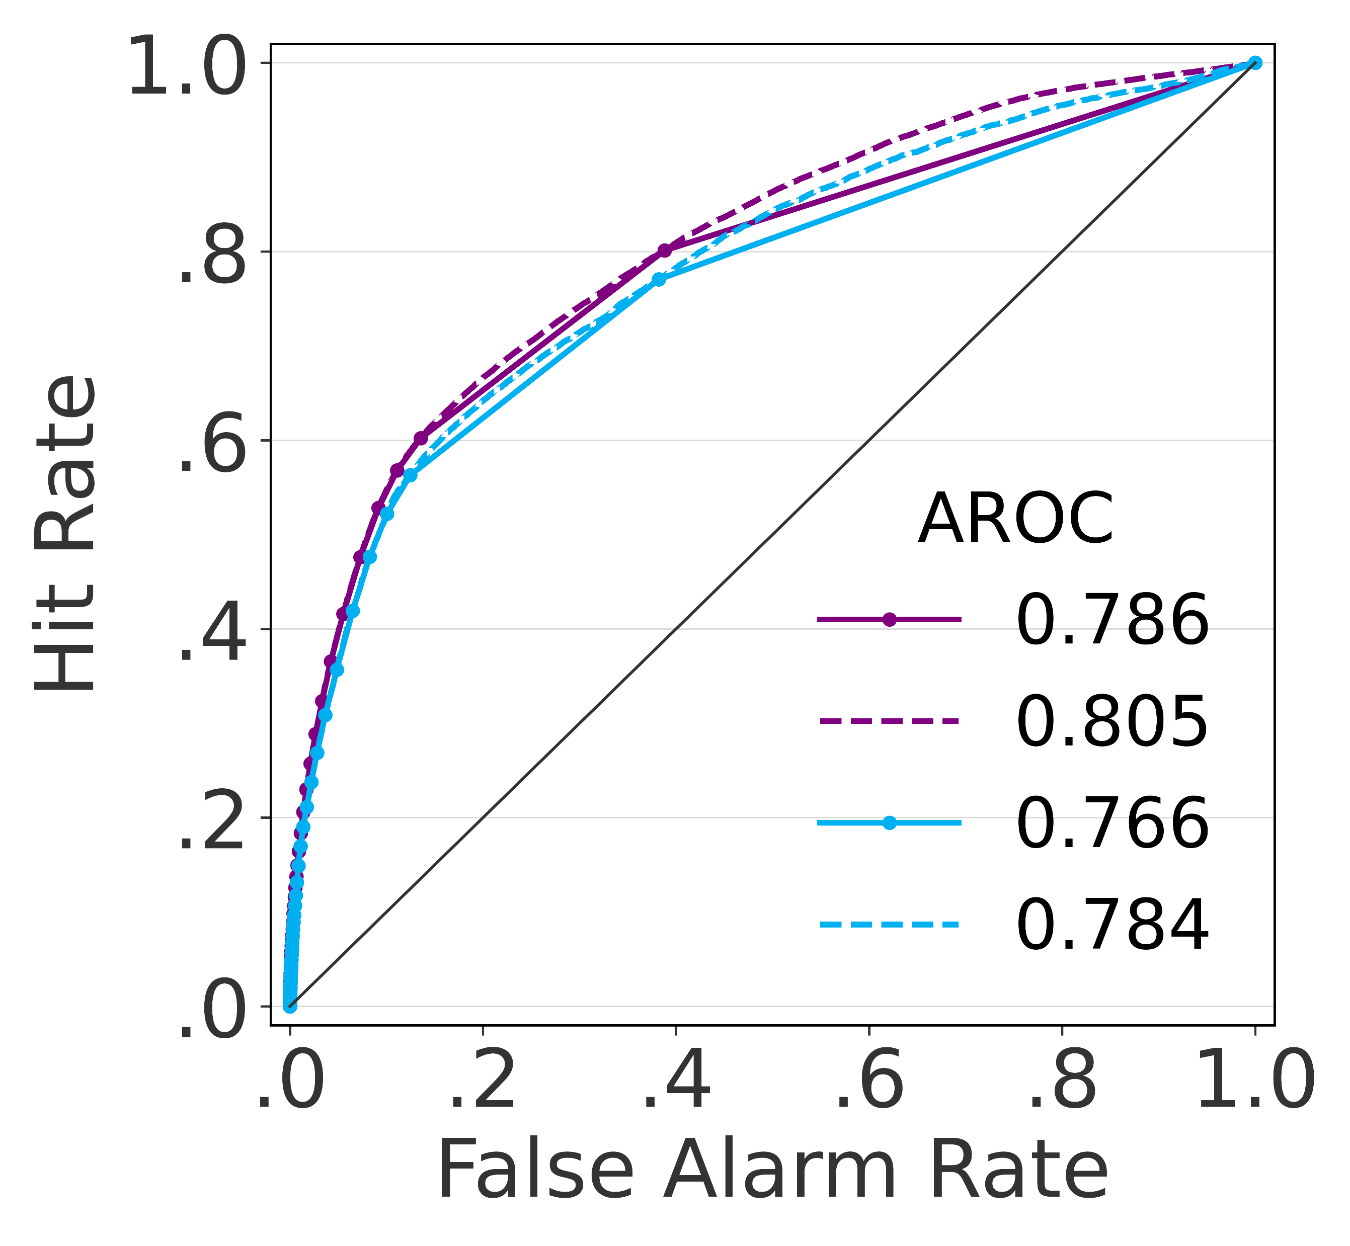
Verification results – ROC curve (breakdown score)
Evaluated over the training and verification datasets
AUC-ROC
AUC-PR
Loss Function Balanced Data
Loss Function
Imbalanced Data
Loss Function Balanced Data
Loss Function Imbalanced Data
RANDOM FOREST XGBOOST
a
g
m
s
RANDOM FOREST LIGHTGBM
b
h
n
t
GRADIENT BOOSTING XGBOOST
c
i
o
u
GRADIENT BOOSTING LIGHTGBM
d
j
p
v
GRADIENT BOOSTING CATBOOST
e
k
q
w
FEED-FORWARD NEURAL NETWORK
f
l
r
x

